Slide 1

CST 499 Final Software Project
Maria Reyes
The University of Arizona Global Campus
CST 499 Capstone for Computer Software Technology
Professor Charmelia Butler
October 23, 2023

Slide 2
Enrollment Software System Build
The objective of this project is to create an online enrollment system for students in an easy-to-understand environment.
The key aspects of the Software Requirements Specification Document are the following:
Create an interactive enrollment process with an innovative structure.
Based on the descriptive analytics system that consists of “digital enrollment data in the era of digital communication” (Lan & Li, 2022, p. 197).
Product functions include: new users register and create profile, login system with ID and password, online courses offered, sign up for courses, database registers and updates, adds and removes courses, heavy manpower is lessen.
System Features include: record keeping, new user registration/log in, and online courses.

Slide 3
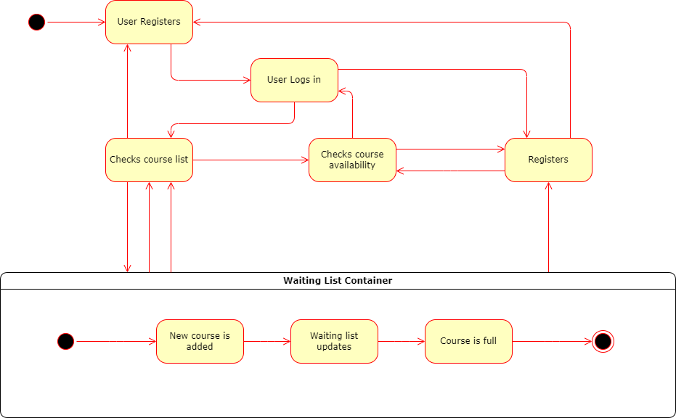
UML Diagram: State
The new user registers into the system.
The log in feature is triggered to enter their student ID and their password.
They enter the registration page.
Registration page notifies users if the class if full.
If full, the system enters into the waiting list container, where the process is completed.

Slide 4
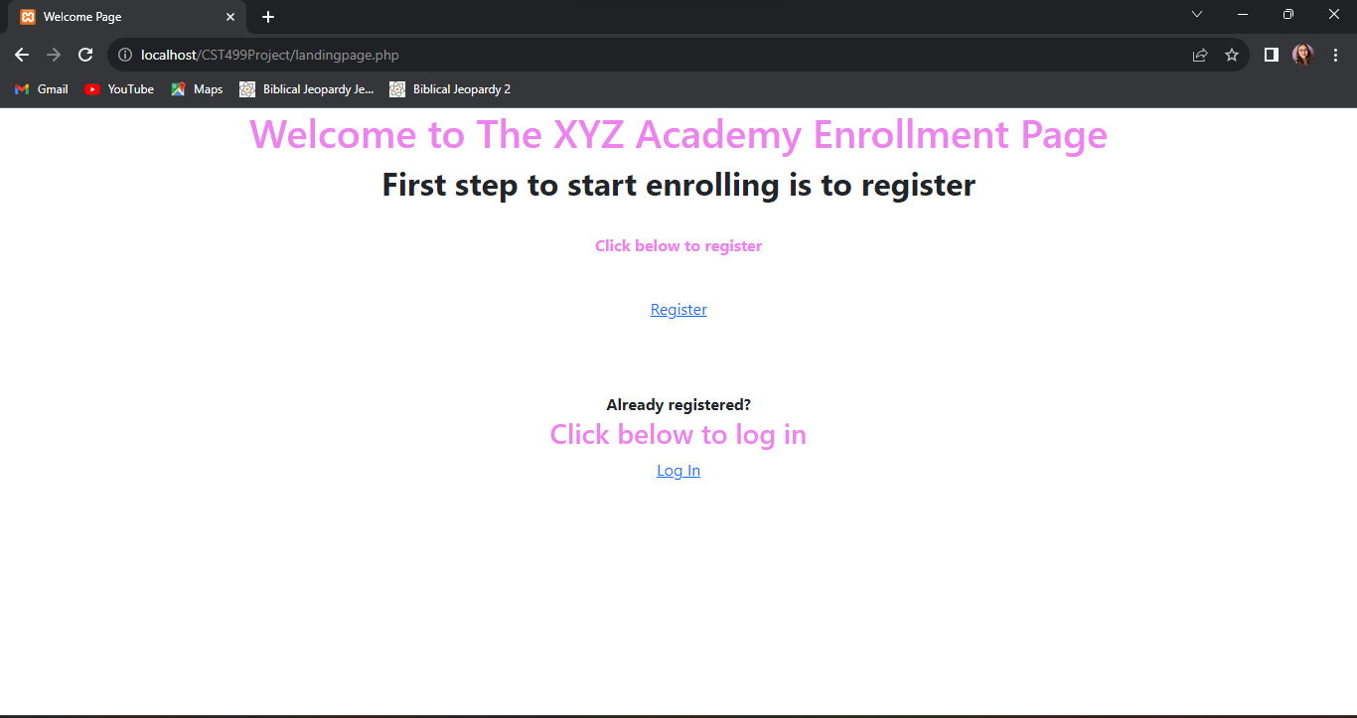
Landing Page
Welcome page features two links: Register and Login
Register leads to registration page
Log In leads to log in page

Slide 5
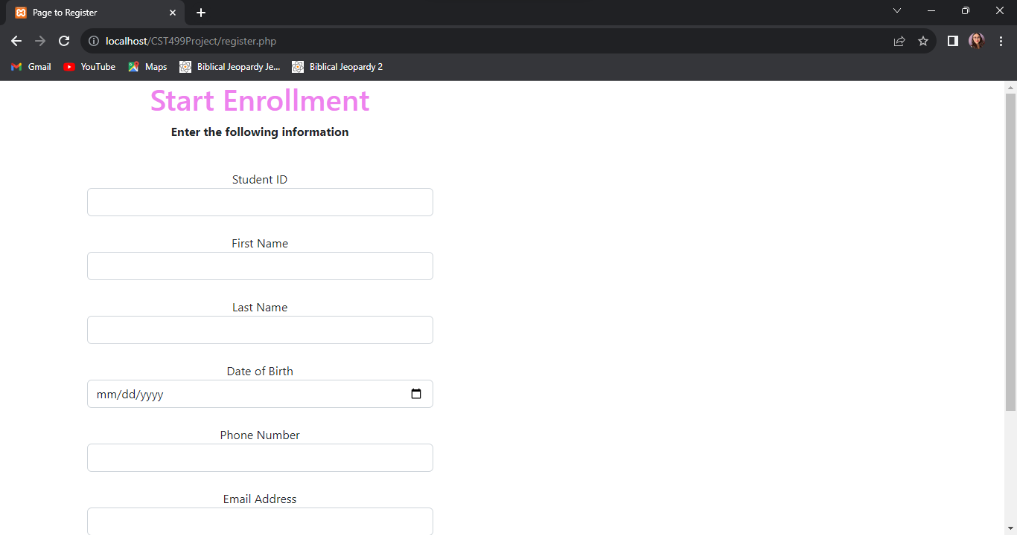
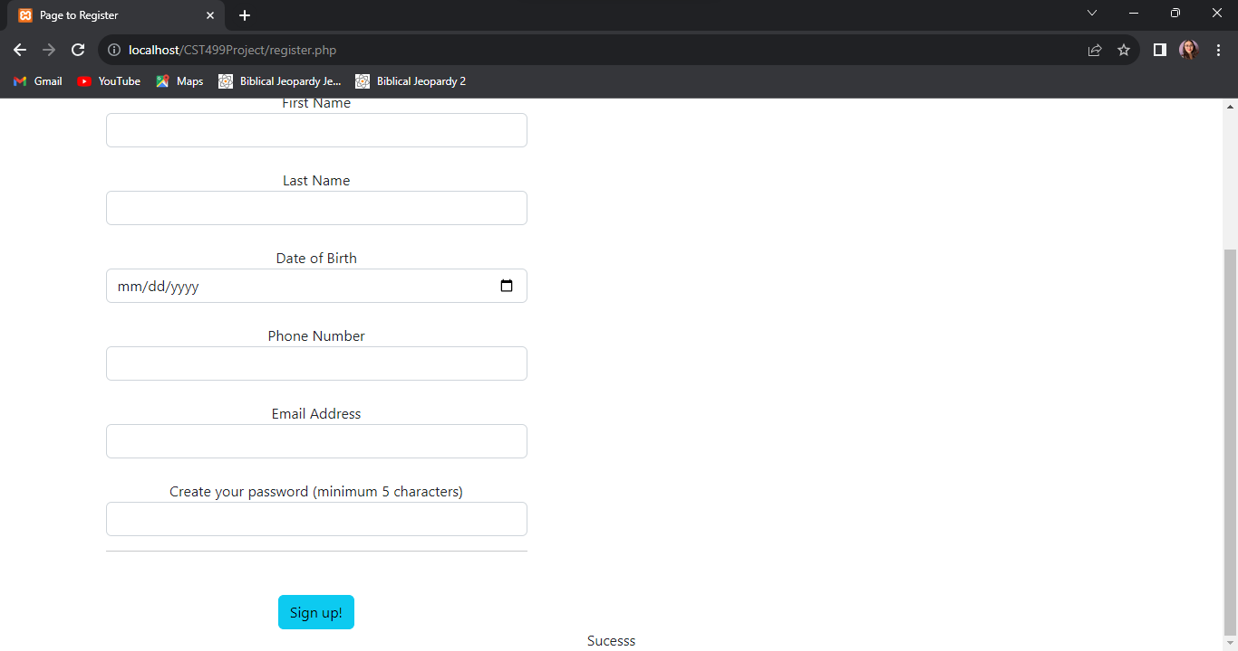
Registration Page
User enters their information
System will not allow user to leave any field empty
User creates their own password
User clicks on sign up button to register

Slide 6
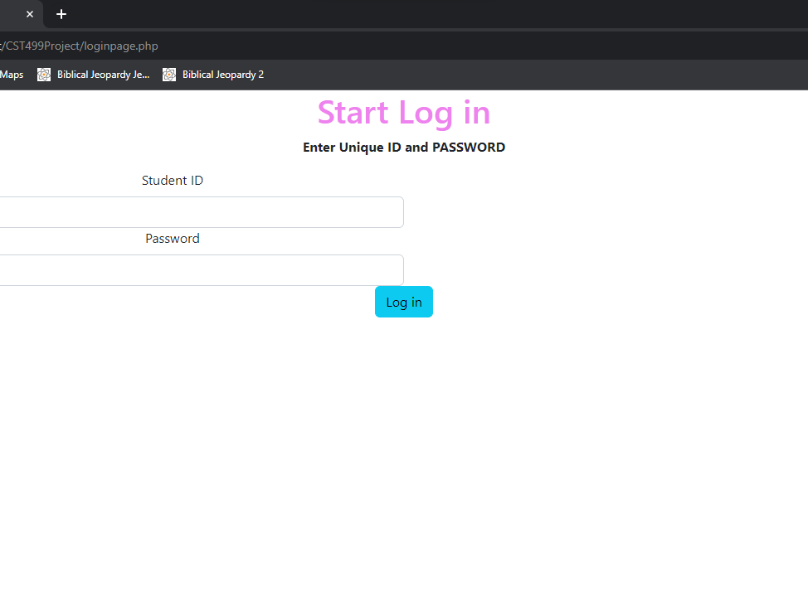
Log In Page
User enters their student ID
User enters their password.

Slide 7
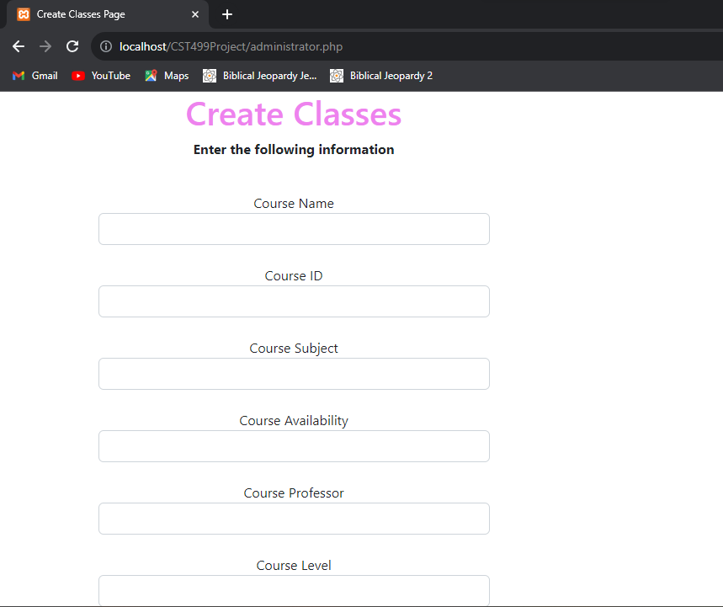

Administrator Page
Administration uses this page to enter new courses into the system
System records all fields into the database
System does not all any empty fields
Administrator confirms their addition of new courses when selecting the add button

Slide 8
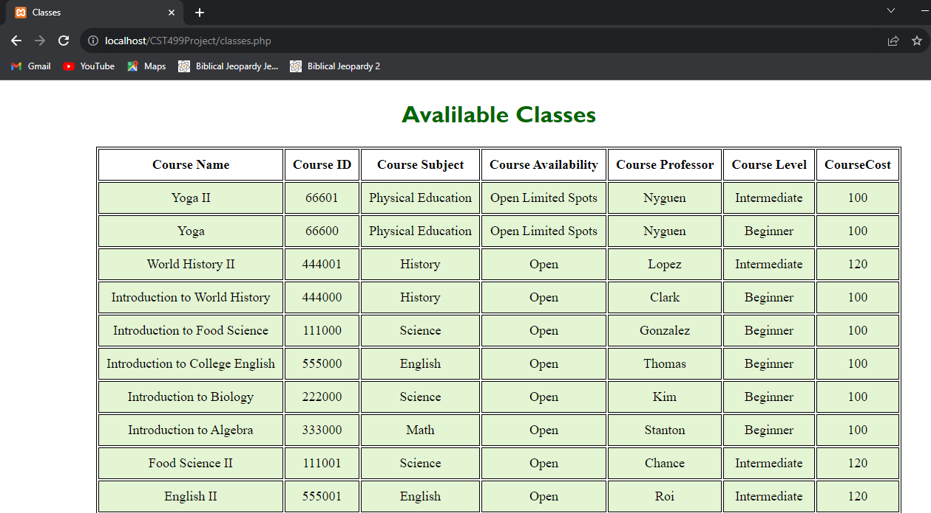
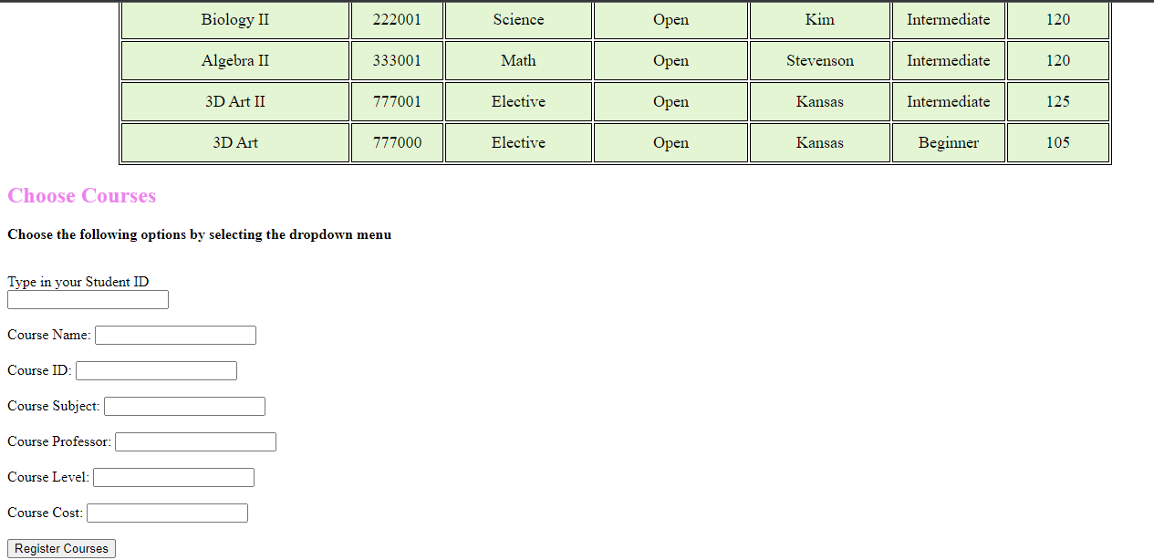
Classes Page
Table is shown of all available classes
Form is shown to choose courses
Different fields are shown to enter key information
Button at the bottom to confirm selection.
Connected to database

Slide 9
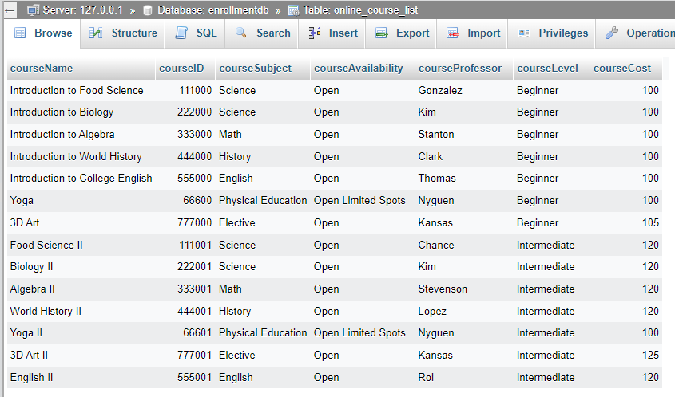
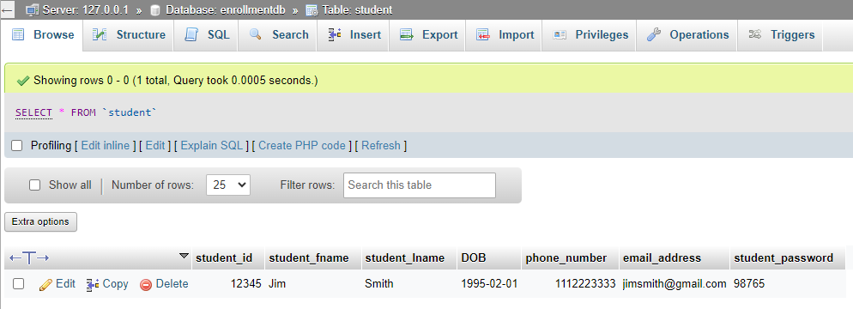
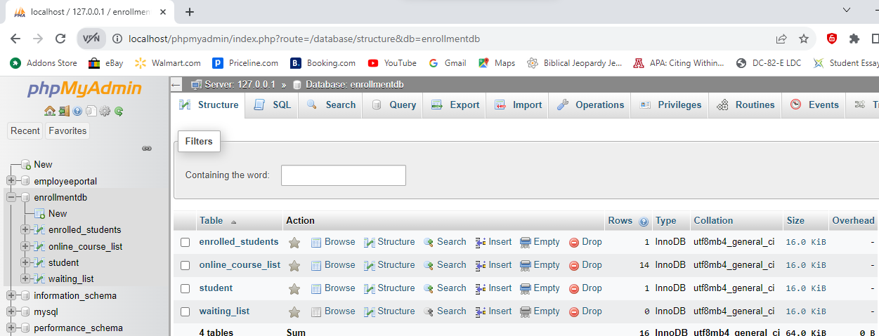
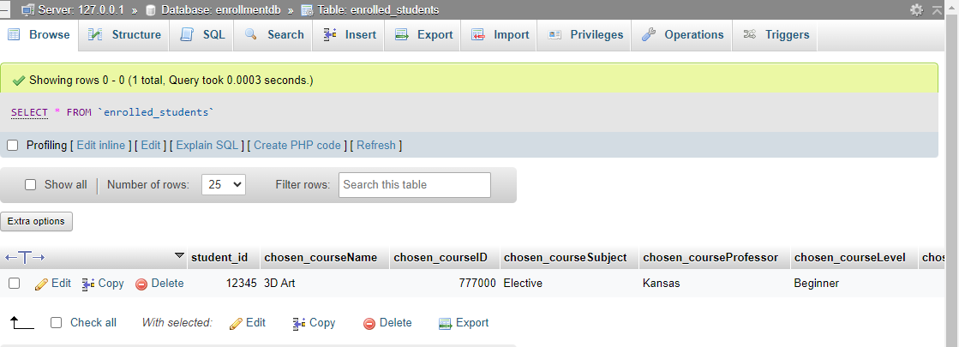
Enrollment MySQL Database and Class Registration
First is the database
Student Table
Online Course List Table
Enrolled Students Table

Slide 10
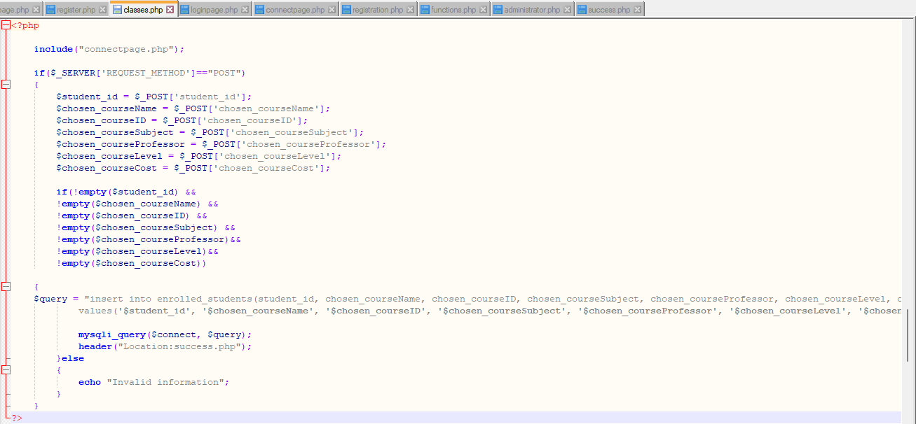
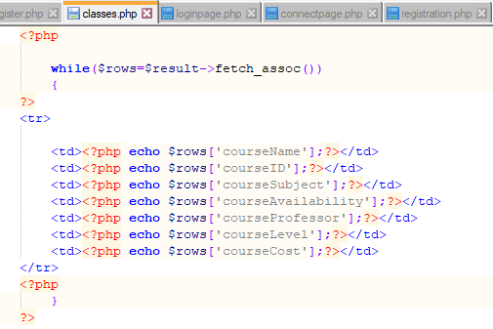
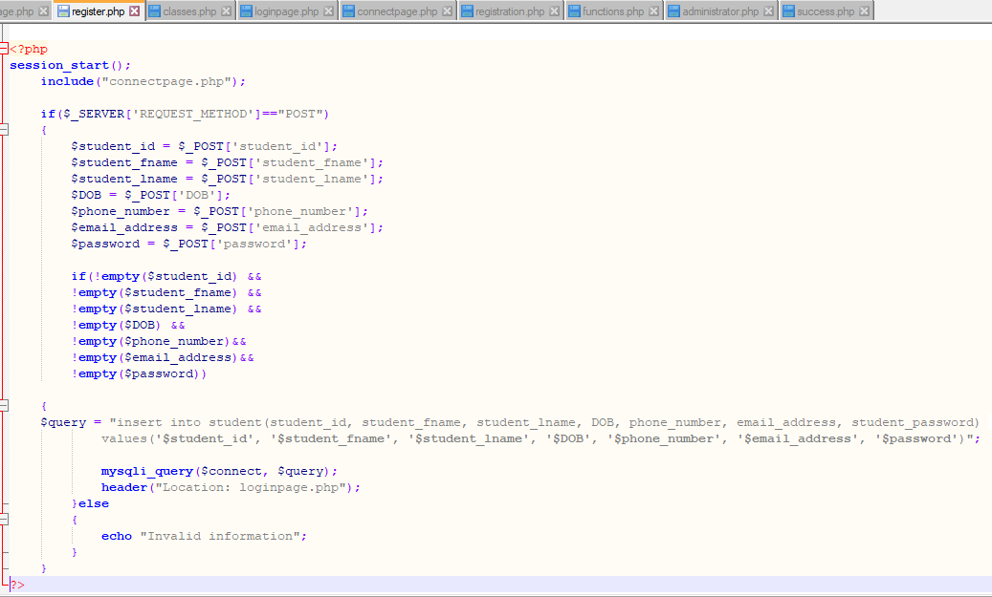
PHP Code Discussed
Registration Page
Classes PHP

Slide 11
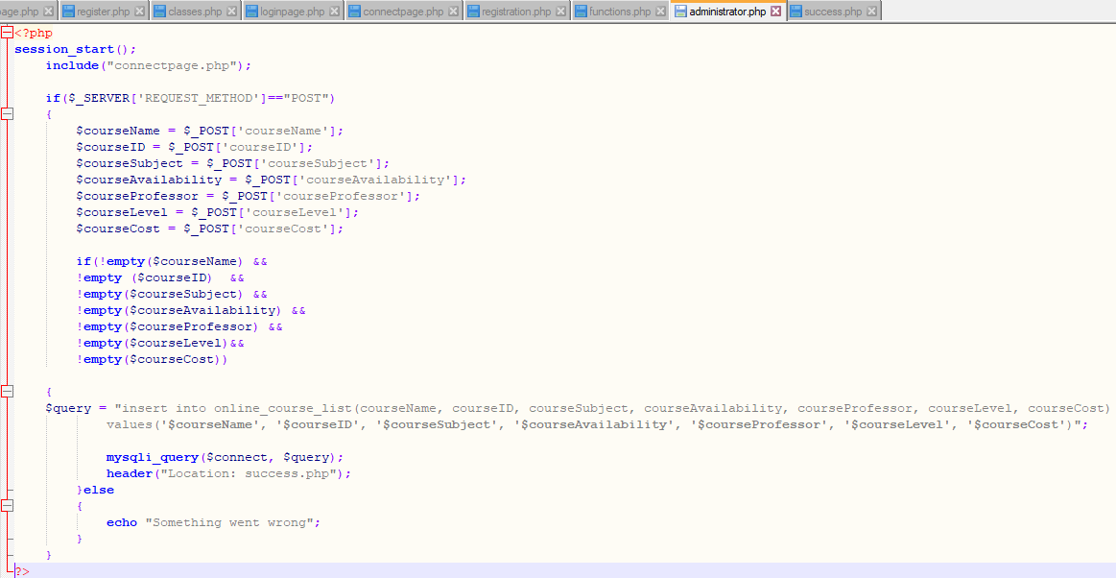
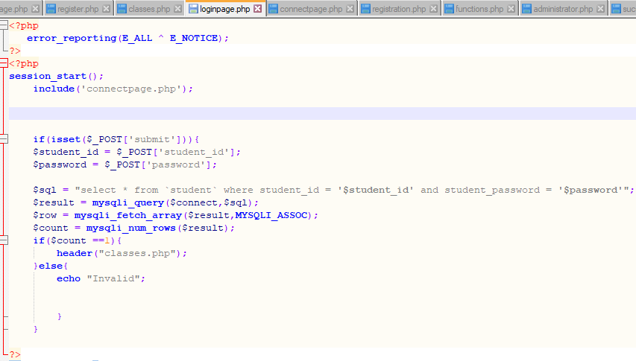
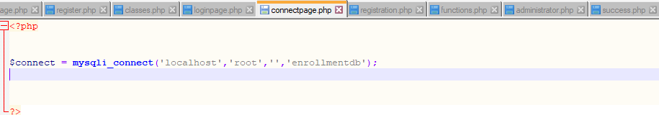
PHP Code Continued
Connection
PHP
Administrator PHP
Log In PHP

Slide 12
Project Experience
Learning about page design was enjoyable.
Code fixes were a challenge.
Code fixes had to do with the fact that “the danger is that the fix cycle may not utilize the same level of the software engineering discipline because may of the problem-fixes may involve only one or two lines-one-code fix” (Tsui et al., 2018, p. 261).
PHP code and overall statements “are considered as dynamic typing statements, and its variable does not need to be declared (just write and use without defining data type” (Odeh, 2019, p. 1520).
Code has to be reviewed multiple times and connected to database properly.

Slide 13
References
Lan, T., & Li, M. (2022). Design of college digital enrollment System based on big data platform in digital communication era. 2022 6th International Conference on Wireless Communications and Applications (ICWCAPP), Wireless Communications and Applications (ICWCAPP), 2022 6th International Conference on, ICWCAPP, 196–200. https://doi.org/10.26483/ijarcs.v10i2.6383
Odeh, A. H. (2019). Analytical and Comparison Study of Main Web Programming Languages --ASP and PHP. TEM Journal, 8(4), 1517–1522. https://doi.org/10.18421/TEM84-58
Tsui, F., Karam, O., & Bernal, B. (2018). Essentials of software engineering (4th ed.). Jones & Bartlett Learning.

